Slide 1
Software Engineering CS 487
Dennis Hood
Computer Science
Fall ‘19
Notes:
This template can be used as a starter file for presenting training materials in a group setting.
Sections
Right-click on a slide to add sections. Sections can help to organize your slides or facilitate collaboration between multiple authors.
Notes
Use the Notes section for delivery notes or to provide additional details for the audience. View these notes in Presentation View during your presentation.
Keep in mind the font size (important for accessibility, visibility, videotaping, and online production)
Coordinated colors
Pay particular attention to the graphs, charts, and text boxes.
Consider that attendees will print in black and white or grayscale. Run a test print to make sure your colors work when printed in pure black and white and grayscale.
Graphics, tables, and graphs
Keep it simple: If possible, use consistent, non-distracting styles and colors.
Label all graphs and tables.

Slide 2

Week 5
Modeling and Architecture
Notes:
This is another option for an Overview slides using transitions.

Slide 3
Lesson Overview
Design: Modeling and Architecture
Reading
Ch. 5 - System Modeling
Ch. 6 - Architectural Design
Ch. 7 – Design and Implementation
Objectives
Explore the design phase
Understand the role of modeling in creating systems – a picture says a thousand words
Examine State-Transition Diagrams which can be used to model system behavior and plan the interface to the user
Discuss the concept of architecture in the context of software systems
Examine architectures to meet the demands of various structural challenges
Analyze the concept of design “patterns” – common solutions to common problems

Slide 4
Homework #2
Design a smart intersection control system which:
Utilizes sensors to efficiently and safely support cars traveling and pedestrians crossing intersecting roads
Deliverable requirements:
Draw a context model
Draw a state-transition diagram
Sketch an information dashboard for pedestrians and another for people in cars
Write pseudo-code for a “sensor failure” exception
Describe your test plan for proving that your system satisfies the “efficiently” and “safely” requirements
Participation for Online Students (2 pages max)
Discuss 3 common solutions to common problems (design patterns) that you rely on in your design and explain the benefit of “common” in this context
Submit to Blackboard by 9/28/19

Slide 5
Modeling
Graphical representations of
Business processes
The problem to be solved
The system to be developed
Purpose
Words have limited effectiveness
A picture can say a thousand words
Bridge the gap from analysis to design
Perspectives
External context
System behavior
Architecture

Slide 6
Context Models
Define the boundaries
Where does the system end and its surrounding environment begin?
Similar to in-scope vs. out-of-scope
Interfaces
Are related components within the boundaries or accessible via defined interfaces?
Boundaries are not necessarily dictated by technical constraints
Business rules, user constraints, etc.

Slide 7
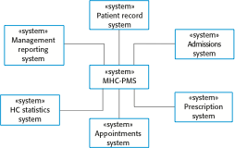
Ex. Context of a Medical System

Slide 8
Interaction Models
Types of interactions to be modeled
User inputs and outputs
Cooperating systems
System components
Use case modeling
Each represents a discrete external interaction
Very high level (narrative is needed for detail)
Sequence diagrams
Captures a sequence of interactions
The sequential flow of a given use case

Slide 9
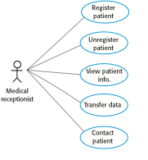
Ex. Use Case Diagram

Slide 10
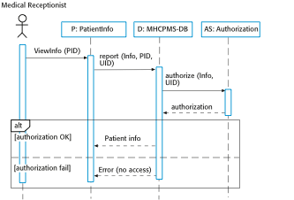
Ex. Sequence Diagram

Slide 11
Structural Models
Capture the system components and their inter-relationships
Class diagrams
OO classes and how they are associated
Model the “real world”
Generalization
Use more general terms to avoid getting “caught” in the details
Members have common characteristics
Aggregation
Building components from sub-components

Slide 12
Perspectives on Reality
Focused on minimizing the abstraction away from the “real” world
Benefits
User “gets” it
Object classes have higher reuse potential
Object behavior and interfaces are more natural
Inheritance and aggregation
Reuse is further enhanced by supporting the concept of similarity among objects

Slide 13
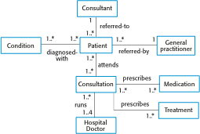
Ex. Classes and Associations

Slide 14

Ex. Class Definition

Slide 15
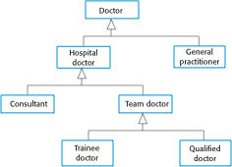
Ex. Generalization Hierarchy

Slide 16

Ex. Aggregation Association

Slide 17
Behavioral Models
Data-flow models
Work is often driven by information flowing through an organization and the manner in which the organization processes, consumes and disseminates it
Where does the information come from?
Who owns it?
How is it processed?, etc.
Event-driven (state machine) models
Organizations move from state to state due to some sort of stimulus
How will the system react to different events?
Who or what will cause each event?, etc.

Slide 18
Ex. State Machine for a Microwave

Slide 19
Data Models
More static view of information than the data flow diagram
Focused on relationships among information types (entity relationships)
Critical design decisions such as unique identifiers and data types begin to take form
Data dictionary
Alphabetic listing of data entities and their descriptions
Helps manage the abstract nature of representing the real world in a system design

Slide 20
Design Patterns
Adopted from the (building) architecture community
Common solutions to common problems
“Why reinvent the wheel?”
Similar benefits as in component reuse
Already proven, already tested
Significant up-front time savings,
even greater potential benefit by avoiding the fix-retest cycle

Slide 21
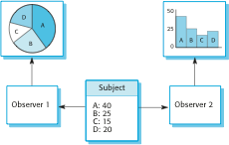
Ex. Observer Pattern
Separate the display of an object’s state from the object itself

Slide 22
From Design to Implementation
Reuse
Abstract reuse via design patterns
Object-oriented design and development
Reusable components
Reusable systems (tailored COTS)
Configuration management
Version control
System build management
Issue management
Host-target development
Configure development host to match target
Simulate target for testing

Slide 23
Architecture
Levels of abstraction
Program-level architecture (“small”)
System- or enterprise-level (“large”)
Designing the building
Solid foundation
Structure that meets basic needs
Support for aesthetic elements
Additional benefits of defined architecture
Means of communicating with stakeholders
Helps to complete the analysis
Facilitates large-scale reuse

Slide 24
Requirements Satisfaction
Non-functional system requirements are largely met through architecture design
Performance optimization
Security
Safety
Availability
Maintainability
Trade-offs are likely necessary due to conflicting priorities and/or overlaps in design elements

Slide 25
Design Decisions
Can an existing generic application architecture be reused?
How will the system be distributed across multiple processors?
What are the appropriate architectural styles or patterns?
How will structural elements be decomposed into modules?
What is the strategy for controlling the operation of system units?
How will the architecture be evaluated?, documented?

Slide 26
Architectural Views
Multiple perspectives help bring complex into focus
Logical – the system as interacting objects
Process – interacting processes
Development – components to be developed
Physical – interacting hardware and software
Conceptual – the basis for decomposing high-level requirements

Slide 27
Architectural Patterns
Layered architecture
Achieve separation and independence through layering
Hierarchical organization
Supports incremental development
Repository architecture
Support the exchange of information between sub-systems
Use a central repository to manage shared data
Establish and maintain a separate database for each sub-system
Client-server architecture
Organized as a set of services and associated servers, accessed by clients “calling” the services
Pipe-and-Filter architecture
Workflow
Information is transformed as it flows through the system

Slide 28
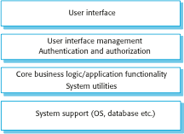
Generic Layered Architecture

Slide 29
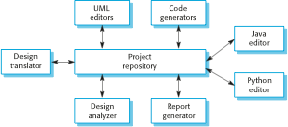
Ex. Repository Architecture

Slide 30
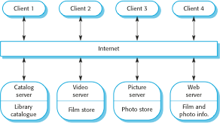
Ex. Client-Server Architecture

Slide 31
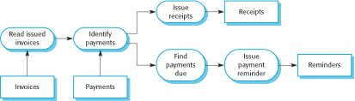
Ex. Pipe-and-Filter Architecture

Slide 32
Application Architectures
Alternatives to system architectures that focus on the needs of the application
Data-processing applications
Transaction-processing applications
Event-processing systems
Language-processing systems

Slide 33
Modular Decomposition Styles
Deciding how best to decompose sub-systems down to modules
Object-oriented decomposition
Loosely coupled objects with well-defined interfaces
Classes are templates with attributes and operations
During execution, objects are instantiated from classes
Function-oriented pipelining
Data flow
Inputs are processed by transformational functions to produce outputs
The “real” world looks more like objects
Therefore, OO works best for reuse
However, work looks more like functions
Therefore, FO provides the best immediate fit

Slide 34
Control Styles
Deciding how best to control modules in operation
Centralized control
Design a sub-system whose primary function is to control the other sub-systems
The vast majority of control is handled by this sub-system
Event-based control
Design each sub-system to “react” to events
Events can come from other sub-systems or the environment
Centralizing provides a single-point of design, implementation, etc. system focus
De-centralizing will often be a more logical fit for modeling the “real” world

Slide 35
Designing Distributed Systems
Spreading the processing load across multiple machines
Benefits
Shared and therefore better utilized resources
Open and therefore more standard-driven systems
Concurrency
Scalability
Fault tolerance
Disadvantages
Complexity
Vulnerable to security breaches
Difficult to manage
Unpredictability

Slide 36
Types of Distributed Systems
Multiprocessor architectures
The operating system can distribute the processes of a software system across multiple processors
The processes must be capable of running independent of each other
Client-server architectures
A centralized server system “offers” services to
de-centralized client processes
Thin-client systems are designed such that all but the presentation is housed at the server
Fat-client systems are designed such that all but the data management is housed at the clients

Slide 37
Client-Server Architecture

Slide 38
3-tier C/S Architecture

Slide 39
Distributed Object Architectures
Less restrictive than client-server in that all objects can offer services to all other objects
Middleware, known as an object request broker, allow distributed objects to communicate across networked computers

Slide 40
Distributed Object Architecture

Slide 41
Distributed Systems Patterns
Master-slave architecture
Real-time systems requiring guaranteed response times
2-tier client-server architecture
Centralized systems for security reasons
Multi-tier C/S architecture
To support high-volume transaction processing
Distributed component architecture
Supports combining resources from different systems
Peer-to-peer architecture
Servers “introduce” peers who then work together locally

Slide 42
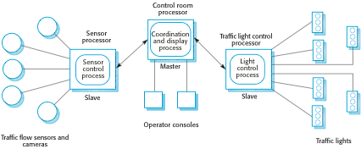
Ex. Master-Slave

Slide 43
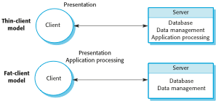
Ex. 2-tier Client-Server

Slide 44
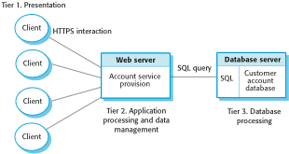
Ex. Multi-tier C/S

Slide 45
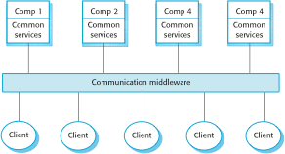
Ex. Distributed Component

Slide 46
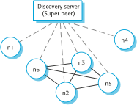
Ex. Peer-to-Peer

